Slide 1

PROGRAMMING IN PYTHON
Overview

Slide 2
Basic Data Types
Data Type
Definition
Boolean
Integer
Complex
Float
Two Values of Logic, associated with conditional statements
Eg: a>b
Positive and Negative Whole Numbers
Eg: a=12, b=-20
Real and Imaginary Numbers
Eg: a= 2+i5
Character enclosed in quotes
Eg: a=num

Slide 3
Variable
Names are assigned to variables using assignment operator
Eg: name = xyz
Name should be short and avoid using names that resemble the functions in python libraries
Use of underscore is allowed
Note: Avoid at the start and the ending while naming the variables
Commonly Accepted Case Types are
Camel Eg : dobEmp DobEmp
Snake Eg: dob_emp Dob_emp
Pascal Eg: DobEmp

Slide 4

Operator
Special symbol that helps in carrying out an assignment operator(or)arithmetic(or) logical operation
Operand
Value that the operator operates on is called as operand

Slide 5
Types of Operators
Assignment Operators
Relational Operators
Bitwise Operators
“=“ Assigning values to left side from right side
“+=“ Adds right operand to the left and stores result on the left operand
“-=“ Subtracts right operand to the left and stores result on the left operand
< strictly less than
<= lesser than (or) equal to
> Strictly greater than
>= greater than (or) equal to
== Equal to
!= Not Equal to
Used when operand are integers
Integers are treated as string of binary bits and operates bit by bit
BITWISE OR – Operator that copies a bit to result if it exist in either operand
BITWISE AND - Operator that copies a bit to result if it exist in both the operand

Slide 6


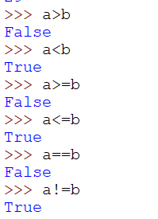
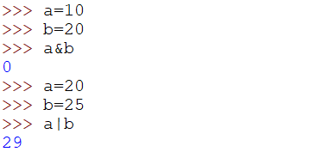
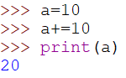
Assignment Operators
Relational Operators

Slide 7
Precedence of Operators
Parenthesis
Exponent
Division
Multiplication
Bitwise OR
Addition/Subtraction
Bitwise AND
Relational Operators
Logical Operators

Slide 8
Lists
Type of data structure, containing ordered collection of objects
Objects in list are called as elements/Components
The Objects are Enclosed between [] brackets
Syntax
Variable_name = [elements]

Slide 9
Operations in Lists
Modifying the Elements
Accessing The Elements
By Index
Using the top level index, the user can change the sub-level components by assigning the values to be changes to corresponding index of the list
Using Append
adds an object to end of list
Syntax: list_name[index].append(object)
Using Insert
adds object at the given position in a list
Syntax: list_name[index].insert(position,object)
Del()
removes the object at the specified index number
Syntax: del list_name[index1][index2]
remove()
removes the first matching object from a list
Syntax: list_name[index].remove(object)
pop()
displays the object that is being removed from the list at the specified index no
Syntax: list_name[index1].pop[index2]
For top level operators use []
For sub-level used [] followed by another []

Slide 10
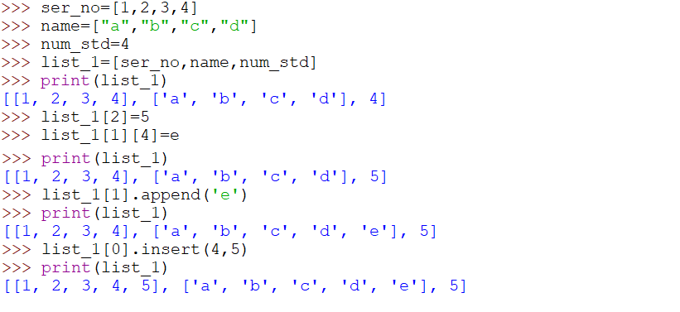
EXAMPLE ON LIST

Slide 11
Tuples
Type of data structure consists of an ordered collection of objects
Enclosed between ()
Immutable
Syntax
variable_name = (elements)
Indexing in TUPLES
Positive Indexing
Starts from left most element, making 0 as the first index to right most element making n as the last index
Negative Indexing
Starts from the right most element, making -1 as the first index to the left most element making –n as last index

Slide 12
Operations in TUPLES
Other allowed Operations
Accessing The Elements
Syntax: tuple_name[index]
len()
To find the length
Syntax
len(tuple_name)
min()
returns lowest value in tuple
max()
returns highest value in tuple
Slicing The Elements
Used to access a set of elements from a tuple by creating a range of index numbers
Syntax:
tuple_name[x:y]

Slide 13
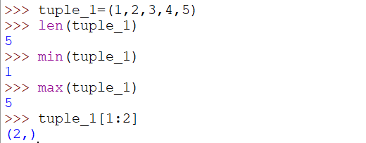

Slide 14
DICTONARIES
Hash Value Data Type Structure
Key-Value Pair where each keys are assigned with values
Enclosed in curly braces {}
CREATING A DICTIONARY
Other Functions
syntax:
dictionary_name = {value: key}
where, Value = Any Python object
Keys = Numbers (or) strings
Example
Name_list={a:1, b:2, c:3}
Accessing Components
Using keys : dictionary_name.keys()
Using values: dictionary_name.value()
To access both: dictionary_name.items
Modifying
By value : dictionary_name[key]=value
By update() : dictionary_name.update({key: value})
Deleting
By delete() : del dictionary_name[key]
Clearing
By clear() : dictionary_name.clear()

Slide 15
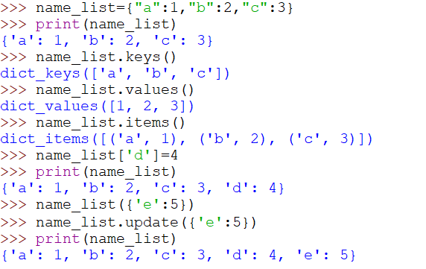

Slide 16
SETS
Collection of Distinct Objects
Does not hold duplicate items
Does not store elements in particular order
CREATING A SET
Other Functions
syntax:
set_name = {}
Example
set_vowels={a, e, i, o, u}
Adding Elements
Using add() : set_name.add(object)
Deleting Matching Objects
By discard() set_name.discard(object)
Clearing
By clear() : set_name.clear()
Union (returns all element of both the sets)
set_A.union(set_B)
Intersection (returns elements common to 2 sets)
set_A.intersection(set_B)

Slide 17
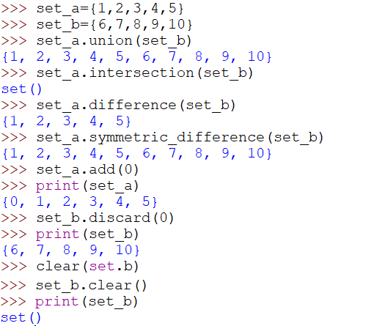

Slide 18

THANK YOU!

